Slide 1
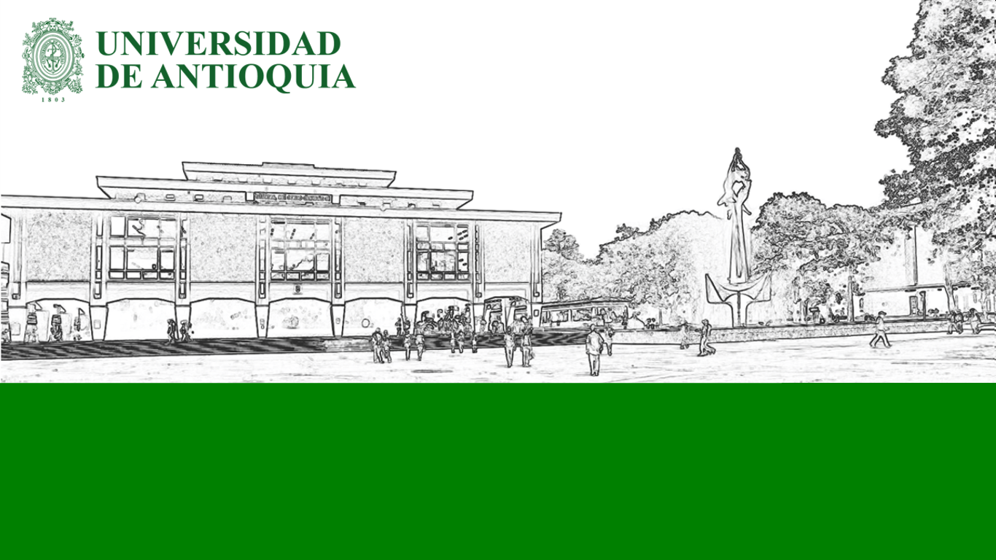
Clustering
Machine Learning II

Slide 2
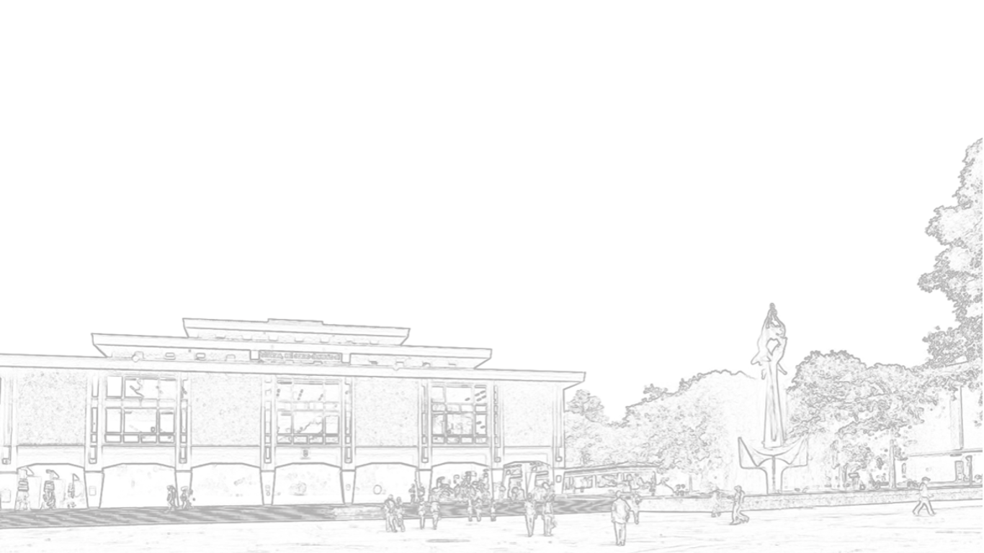
Prerequisites

Slide 3

Checklist
Linear Algebra
Vector-vector distance
Probability
Mean
Median
Programming
Control structures
Computational complexity
Convergence

Slide 4
Introduction

Slide 5
Why do we need Clustering?

Slide 6
Use Cases
Topic discovery

Slide 7
Use Cases
Topic discovery
Patient clustering (clinical trials)

Slide 8
Use Cases
Topic discovery
Patient clustering (clinical trials)
Customer market segmentation

Slide 9
Use Cases
Topic discovery
Patient clustering (clinical trials)
Customer market segmentation
Guess missing entries

Slide 10
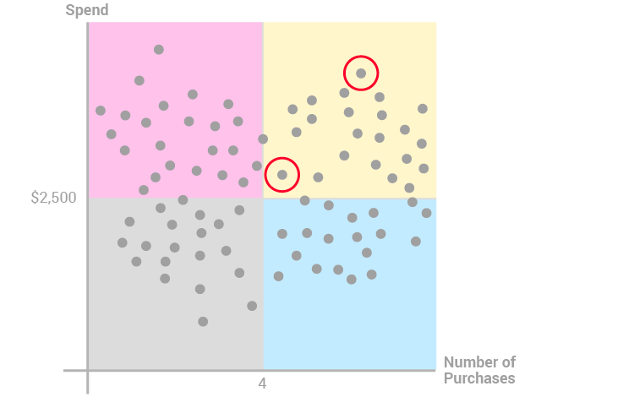
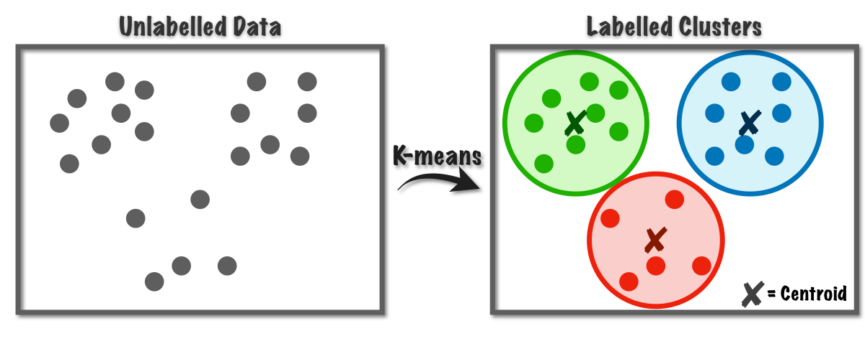
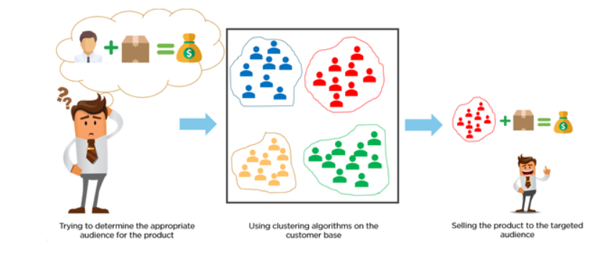
Use Cases
Topic discovery
Patient clustering (clinical trials)
Customer market segmentation
Guess missing entries
Credit score grouping

Slide 11
Let’s get started!

Slide 12
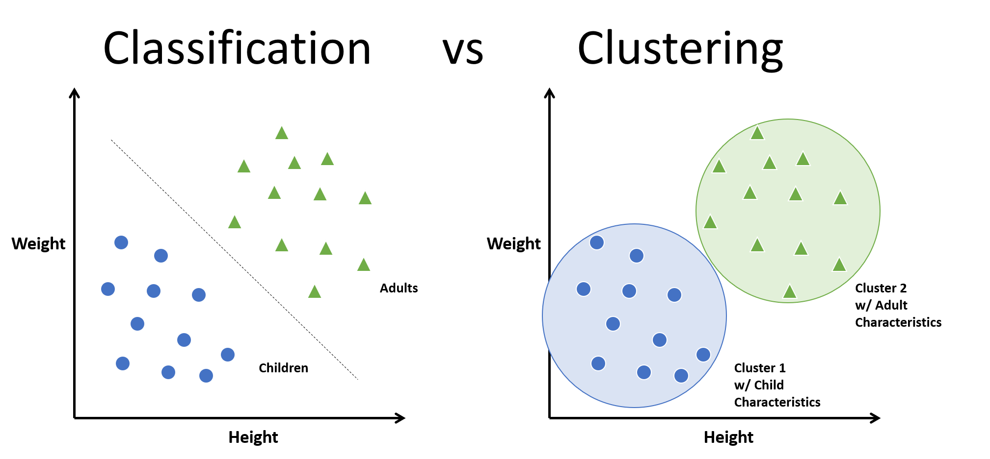
Clustering
Group or partition vectors into K groups or clusters
Normally, K « N
Unlabeled. Clustering ≠ Classification.

Slide 14
K-Means

Slide 15
Introduction
Now we know how to cluster in both scenarios
Fixed representative vectors
Fixed cluster assignment
Issue: they are circularly dependent
Solution: iterate between the 2 choices

Slide 16
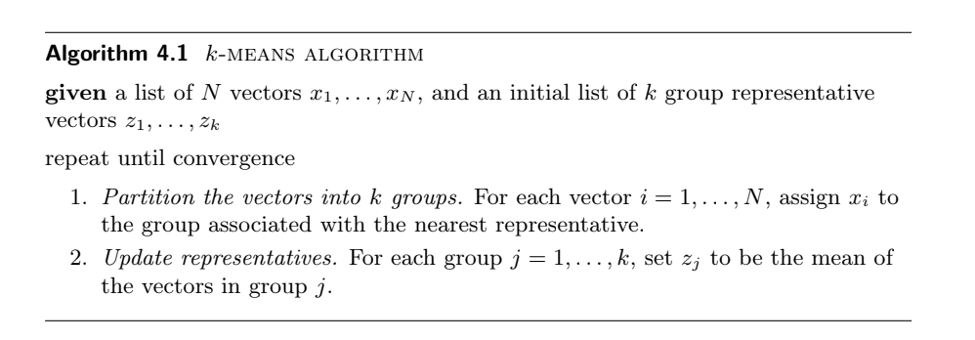
Algorithm

Slide 17
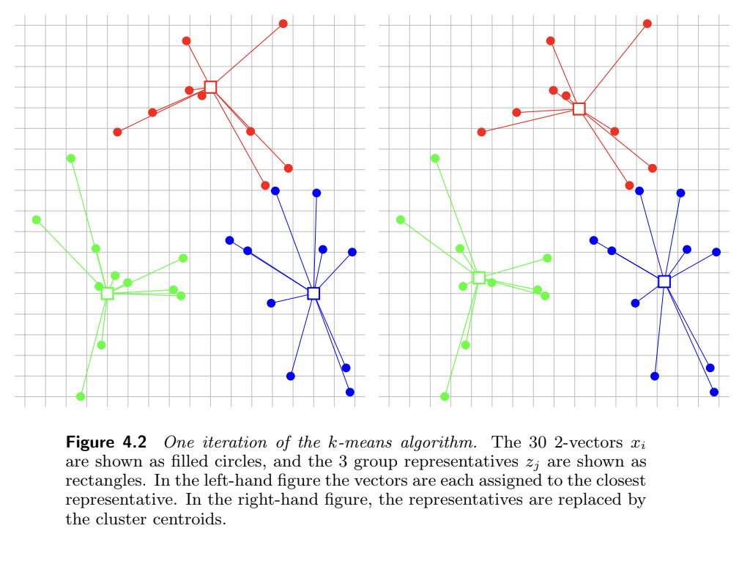
Algorithm

Slide 18
Convergence
Since J_cluster decreases, the algorithm converges in a finite # of steps
Final output depends on the initial conditions
K-means is not an exact method, but a heuristic
Does not guarantee that partitions minimize J in each case
Pro tip: run it several times, varying initial conditions

Slide 19
Interpretability
Vectors Z are mean vectors for each cluster
Same dimensions as input data
Each feature in Z vectors corresponds to same feature in input data
Z vectors hold the mean value for each feature for a given cluster
Very interpretable

Slide 20
Challenges
??

Slide 21
Challenges
Dependence on initial setup
Mean is sensitive to outliers
Fixed K, must be assumed beforehand

Slide 22
K-Medoids

Slide 23
Introduction
K-means is sensitive to outliers
Medoids: most centrally located objects in a cluster
Existing objects (in the dataset)

Slide 24
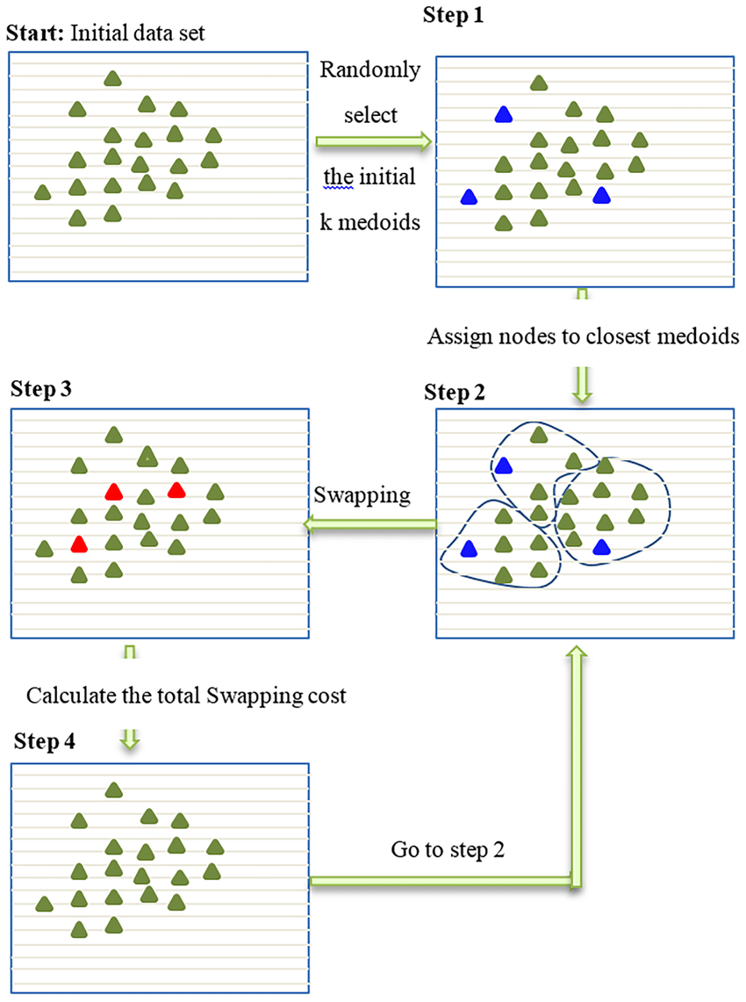
Algorithm

Slide 25
Challenges
PAM is an algorithm to compute K-medoids
Computationally inefficient: O(k(n-k)^2)
There are some recent improvements in the above
Many already included in ML/statistical packages
Still need to know K beforehand

Slide 27
Silhouette

Slide 28
Introduction
Check the separation distance between the resulting clusters
Gives a notion of how well a record was classified in a certain cluster
The silhouette plot displays a measure of how close each point in one cluster is to points in the neighboring clusters
Score [-1, 1]

Slide 29
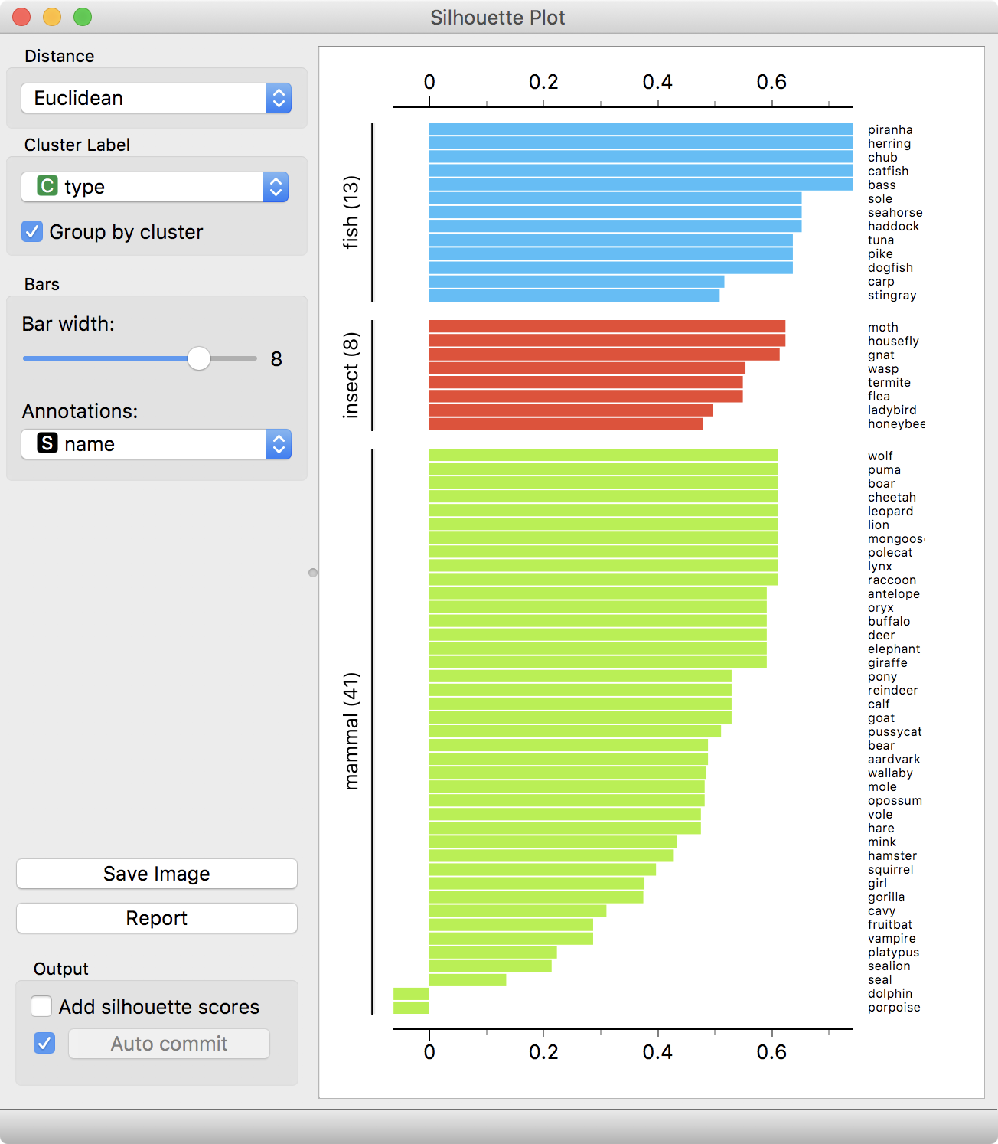
Structure

